Slide 1


K.RAMAKRISHNAN COLLEGE OF TECHNOLOGY
(AUTONOMOUS), TRICHY.
PERSONAL FINANCE MANAGEMENT
PRESENTED
S.HARIPRIYA
2303811710422056
SUPERVISOR
Mr. M. Saravanan, M.E.,
AP/CSE.

Slide 2
PRESENTATION OVERVIEW
Objective
Project Introduction
Problem Statement
Methodologies (Programming concepts relevant to problem statement)
Architecture of the proposed system
List of Modules
Merits
Results and Discussion
Queries

Slide 3
OBJECTIVE
The objective of the Personal Finance Management project using Java is to create an application that helps users track their income, expenses, and savings. The system will provide features like budgeting, financial reports, and goal-setting to assist in making informed financial decisions.

Slide 4
PROJECT INTRODUCTION
This Personal Finance Management project, developed in Java, helps users efficiently manage their income, expenses, and savings. It provides features such as budget tracking, expense categorization, and financial reporting to promote better financial planning. The project is designed with user-friendly interfaces and ensures data security for personal financial information.

Slide 5
PROBLEM STATEMENT
The Personal Finance Management project in Java aims to help users track and manage their income, expenses, and savings efficiently. It provides features such as budgeting, transaction categorization, and generating financial reports to promote better financial planning.

Slide 6
METHODOLOGIES
A personal finance management project using Java focuses on helping users efficiently track and manage their income, expenses, savings, and budgets. By leveraging object-oriented programming principles, the project can include modules for transaction tracking, budget planning, and financial reporting. It employs Java libraries for file handling, GUI development (e.g., JavaFX), and data persistence to ensure a user-friendly and scalable solution.

Slide 7
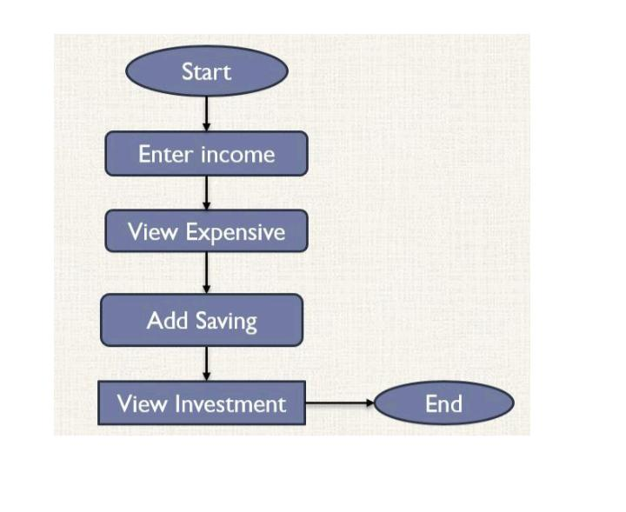
ARCHITECTURE OF THE PROPOSED SYSTEM

Slide 8
LIST OF MODULES
MODULE DESCRIPTON
User Management: Handles user profiles and authentication. Income Tracking: Logs and categorizes income sources. Expense Tracking: Records and categorizes expenses with insights. Budget and Savings Management: Sets and monitors budgets, savings goals, and financial progress.

Slide 9
MERITS
Automation: Streamlines tracking and budgeting tasks. Customization: Tailors financial management to individual needs. Security: Ensures sensitive financial data is securely handled. Scalability: Easily adapts to varying levels of financial complexity.

Slide 10
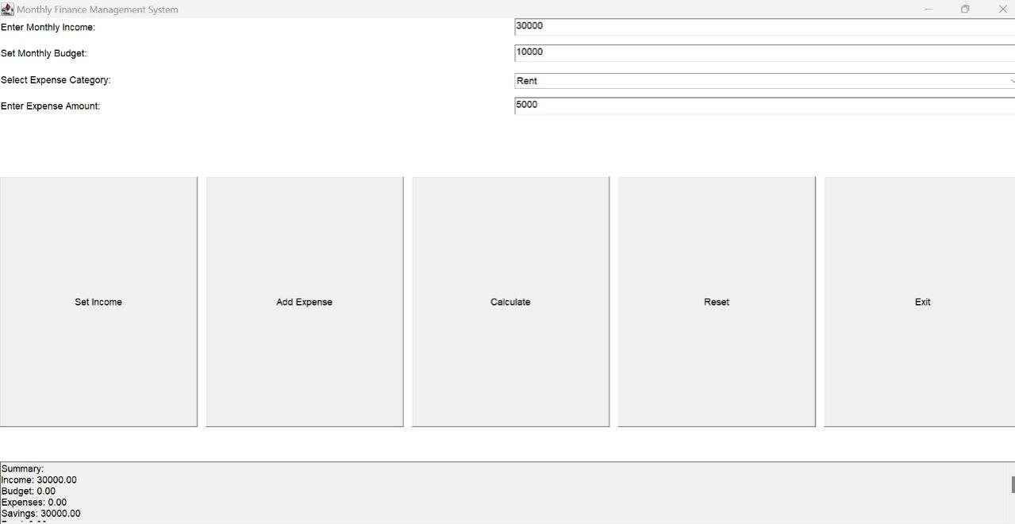
RESULTS AND DISCUSSION

Slide 11
QUERIES ?

